Slide 1


Dhanraj Enterprise
Agro Products & Commodities Supplier & Exporter

Slide 2
About Us
Dhanraj Enterprise is a leading exporters and suppliers of agricultural products and other commodities.
We manufacturer products like oil seeds, spices, dry fruits, pulses & grains, herbs, animal feeds, coconuts products etc.
Established in 2008, we are able to supply you finest quality products from the most reliable pre-screened sources. We have well trained & experienced staff having efficient knowledge of global trade.
We are customer oriented and prefer open communication & transparency. Creating long-term partnerships is our main effort. Our young energetic and enthusiastic & experienced team is always ready to provide professional service while managing quality and timely shipments.

Slide 3
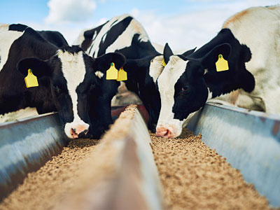

Our Products
Animal-Feed
Yellow-Maize

Slide 4
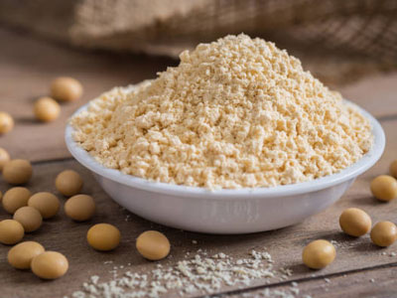
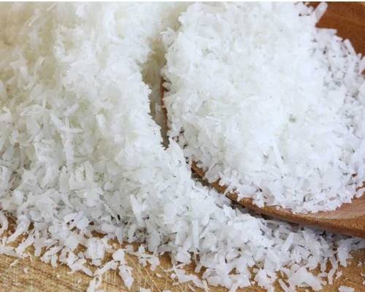
Soyabean-Meal
Desiccated-Coconut

Slide 5
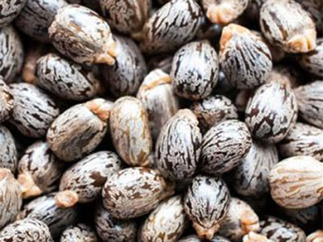

Oil-Seed
Spices

Slide 6

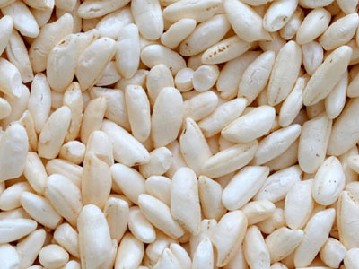
Dry-Fruits
Pulses

Slide 7
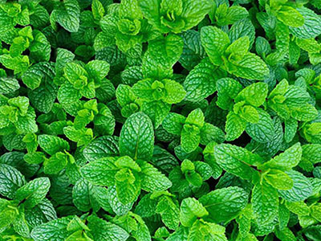
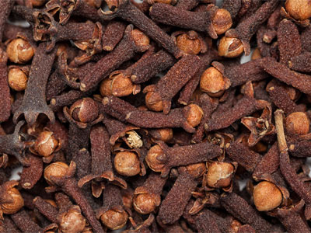
Herbs
Other-Origins

Slide 8
Contact Us
Mobile No: +91 99784 50854
Email Id: info@dhanrajenterprise.in
Address: 106, Arihant Complex, Virani Chowk, Tagor Road, Rajkot, Gujarat, India 360001
Working Hours: 9 AM TO 6:00 PM
Website: https://dhanrajenterprise.in/
Facebook: https://www.facebook.com/Dhanrajenterprise1/
Linkedin: https://www.linkedin.com/company/dhanraj-enterprise/people/?viewAsMember=true

