Slide 1
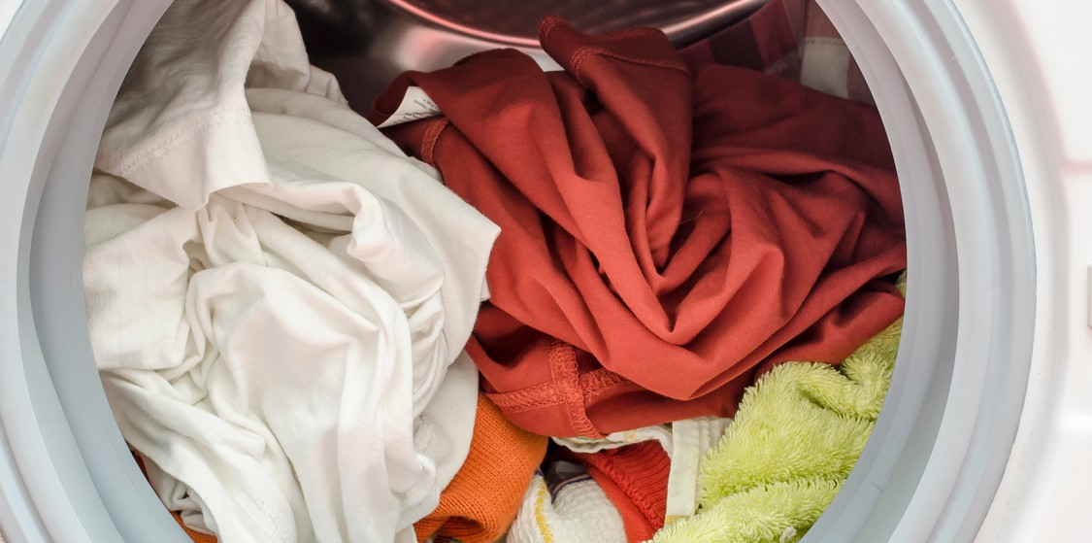

Hapiso laundry pods with 5-in-1 benefits
Plant-based | Gentle on clothes & tough on stains
Zero waste Packaging
Cleaner, brighter colours & whites and softer fabric.
Each pod is fully dissolvable in water.
Long-lasting fragrance from essential oils.
1 Pod = 1 full load
(6-7 kgs)
Plant-Based Ingredients: Hapiso pods are made with natural, chemical-free, and plant-based ingredients, ensuring a gentle touch on your clothes while combating stubborn stains effectively.
Enhanced Cleaning Power: These pods clean thoroughly and revitalize colors and whites, leaving your fabrics feeling softer and brighter.
Smart Design: With their pre-measured formula, Hapiso pods prevent overdosing, and their fully dissolvable PVA film means no residue. Just pop one pod for one full load, regardless of your washing machine type.
Long-Lasting Fragrance: Enjoy a lingering, refreshing scent from essential oils, creating a delightful, long- lasting aroma that stays with your freshly laundered clothes.
Environmentally Conscious Packaging: Packaged in a compostable paper box, Hapiso is dedicated to a modern, zero-waste laundry routine, ensuring sustainable practices from start to finish.

Slide 2
Our Products
Fragrance Free Hapiso Laundry Pods
Tropical Breeze Hapiso Laundry Pods
Morning Dew Hapiso Laundry Pods
The Happy Box
Rs. 299
Rs. 299
Rs. 299
Rs. 1099
Morning Dew Hapiso Laundry Pods: Experience the freshness of the morning dew with our innovative liquid laundry detergent pods. Specially crafted for a long-lasting, good-smelling fragrance that lingers on your clothes all day. Say goodbye to the hassle of measuring and pouring—simply pop in a pod and let the magic unfold!
Tropical Breeze Laundry Pods: Transport yourself to a paradise
of clean laundry with our scented, easy-to-use detergent pods. Let the tropical breeze infuse your fabrics with a delightful, long-lasting smell that reminds you of sun-kissed beaches and swaying palm trees. Laundry day just got a whole lot more refreshing!
Fragrance-Free Laundry Pods: Catering to sensitive skin needs,
our fragrance-free laundry pods provide an odor-rescue solution for those with eczema or allergies. Designed to be hypoallergenic and safe for pets and little ones, these unscented pods ensure a gentle yet effective cleanse for your delicate fabrics.
The Happy Box: Embrace the joy of gifting and sustainable living
with our eco-friendly Happy Box. This thoughtful ensemble includes 2 Hapiso Laundry Pods (1 Tropical Breeze and 1 Morning Dew) for a delightful laundry experience. Alongside, revel in the "All Things Happy" ultra-utility canvas bag and 2 Gardenia Soy Wax candles, perfect for creating a serene and environmentally conscious ambiance. Treat yourself or a loved one to this eco-conscious delight!

Slide 3
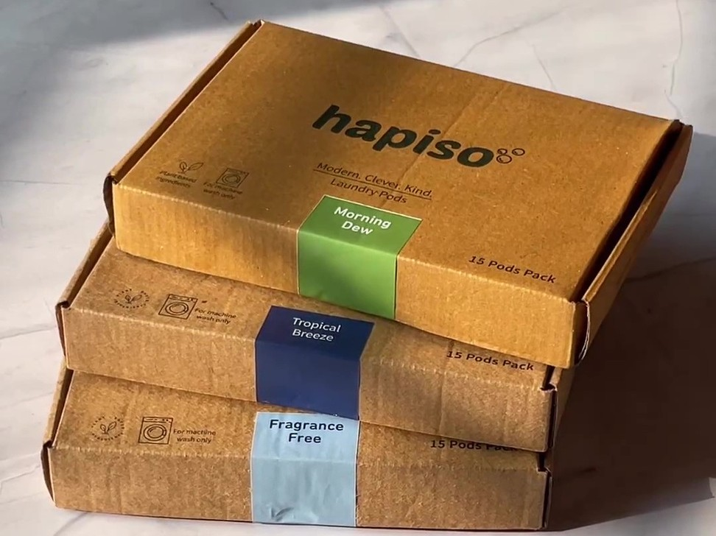
Monthly Hapiso liquid laundry detergent pods subscription
Get your Hapiso liquid laundry detergent pods hassle-free every month.
Subscribe and save up to 32%.
Select your preferred product and subscription duration, then make your payment.
With a 6-month plan, every third pack is FREE.

Slide 4

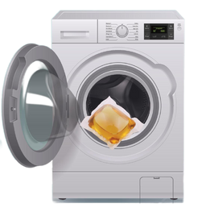


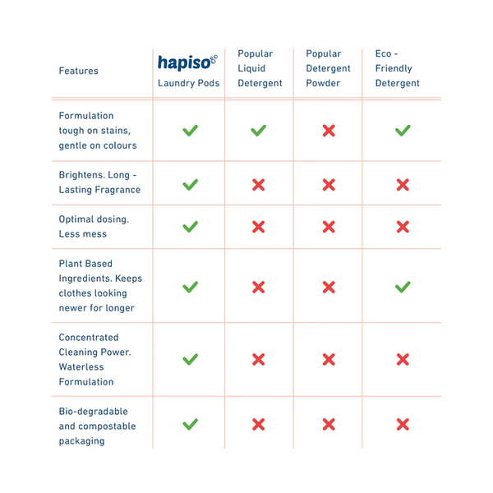
Hapiso laundry pods
The Eco-Friendly Choice for Effective Cleaning
How to use Hapiso laundry pod
1.
2.
3.
Pop the pod into the washing machine.
Load the laundry.
Press start.
Fresh, fragrant, and clean clothes are ready.

