Slide 1

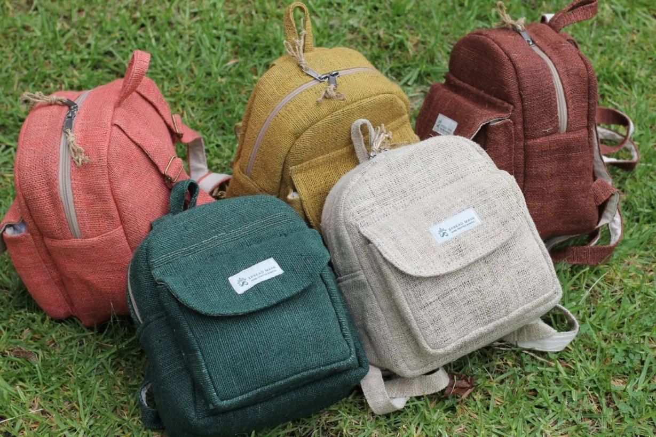
CATALOG
NEW COLLECTION 2025
https://spreadmaya.com.au

Slide 2
ABOUT US
At the heart of our journey is a commitment to an eco-conscious movement. We believe in living harmoniously with nature, and our mission is to offer products that reflect this philosophy.
We proudly offer a range of sustainable, vegan, organic, and ethical products made from wild Himalayan hemp. Our handcrafted creations embody the principles of respect for the environment and compassion for all living beings.
Join us on our journey to promote a sustainable, ethical, and natural way of life. Discover the beauty and benefits of handcrafted wild hemp products and be part of a movement that values tradition, people, and the planet.

Slide 3
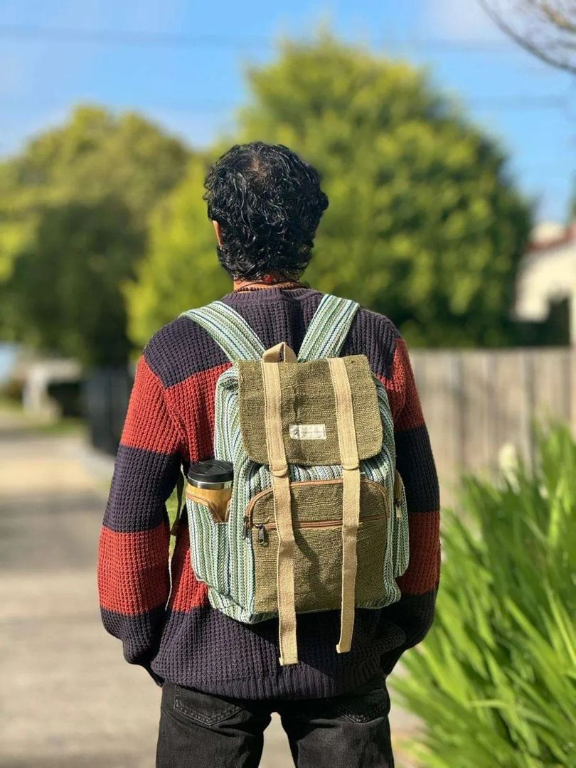
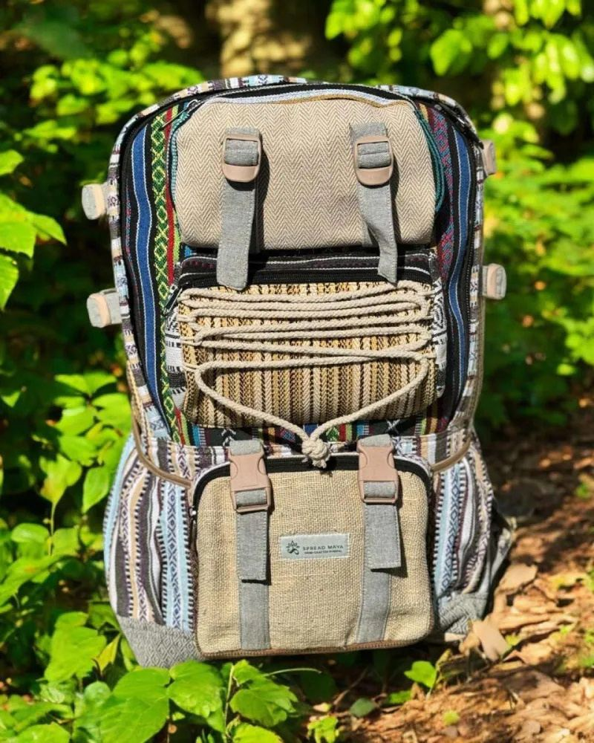
HEMP BAGS COLLECTION
Explore our whole range of handmade hemp bags, lovingly designed in Australia. We have a wide collection of hemp bags, backpacks, crossbody bags, duffle bags, laptop bags, yoga bags, musical instrument bags and many more eco-friendly bags.
Urban Hemp Backpack
Hemp Travel Bag

Slide 4
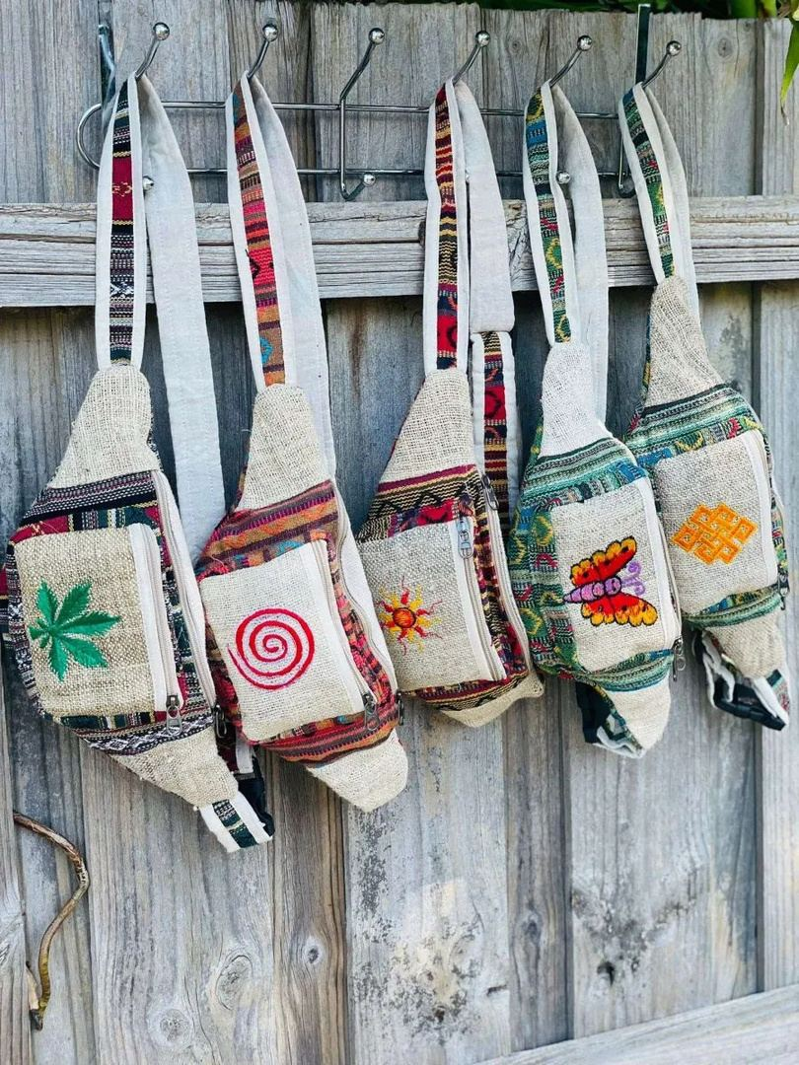
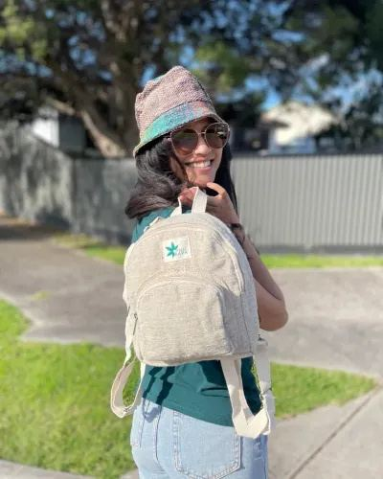
HEMP BAGS COLLECTION
Explore our whole range of handmade hemp bags, lovingly designed in Australia. We have a wide collection of hemp bags, backpacks, crossbody bags, duffle bags, laptop bags, yoga bags, musical instrument bags and many more eco-friendly bags.
Printed Hemp Bum Bags
Mini Hemp Backpack

Slide 5
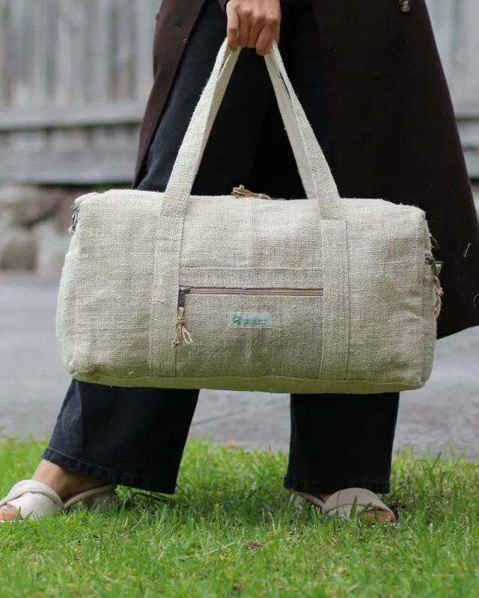
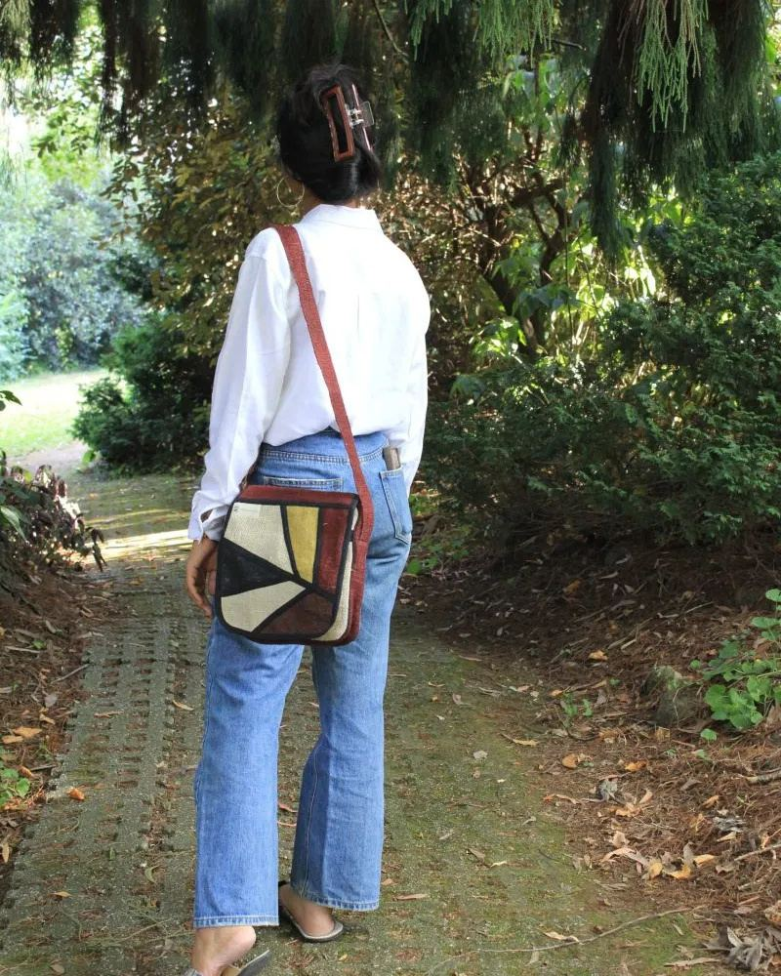
HEMP BAGS COLLECTION
Explore our whole range of handmade hemp bags, lovingly designed in Australia. We have a wide collection of hemp bags, backpacks, crossbody bags, duffle bags, laptop bags, yoga bags, musical instrument bags and many more eco-friendly bags.
Natural Hemp Duffle Bag
Hemp Side Bag

Slide 6
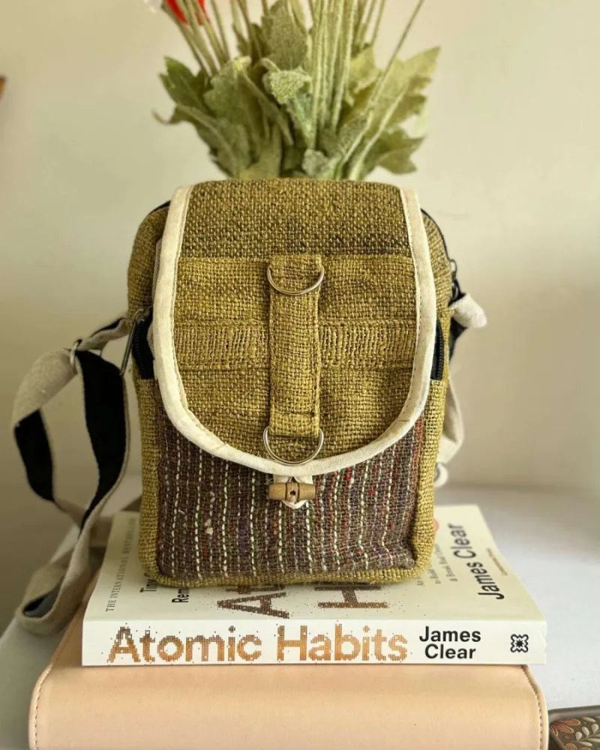
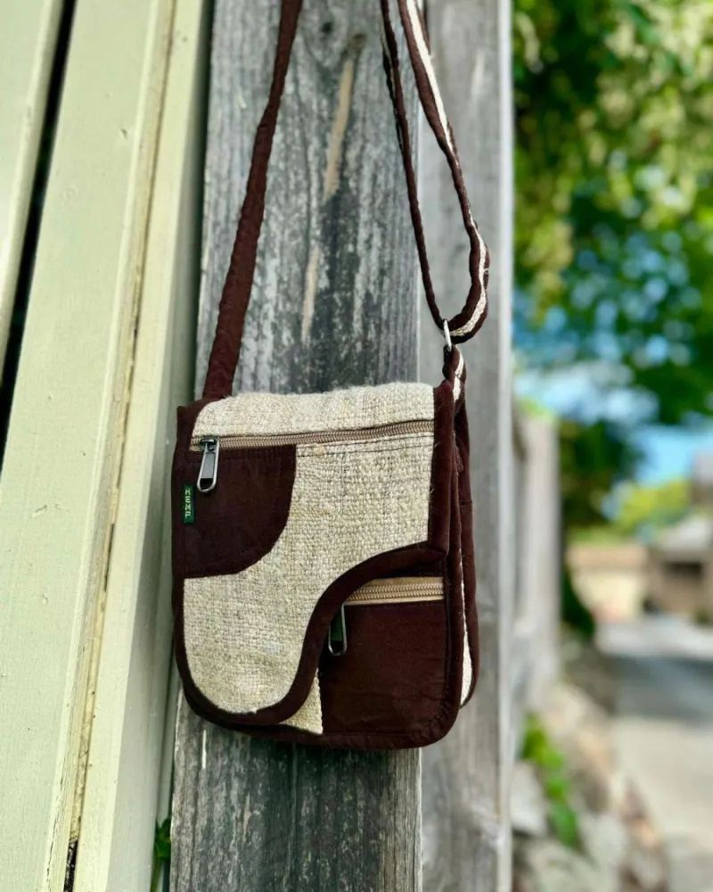
HEMP BAGS COLLECTION
Explore our whole range of handmade hemp bags, lovingly designed in Australia. We have a wide collection of hemp bags, backpacks, crossbody bags, duffle bags, laptop bags, yoga bags, musical instrument bags and many more eco-friendly bags.
Ecochic mini hemp side bag
Brown Hemp side bag

Slide 7
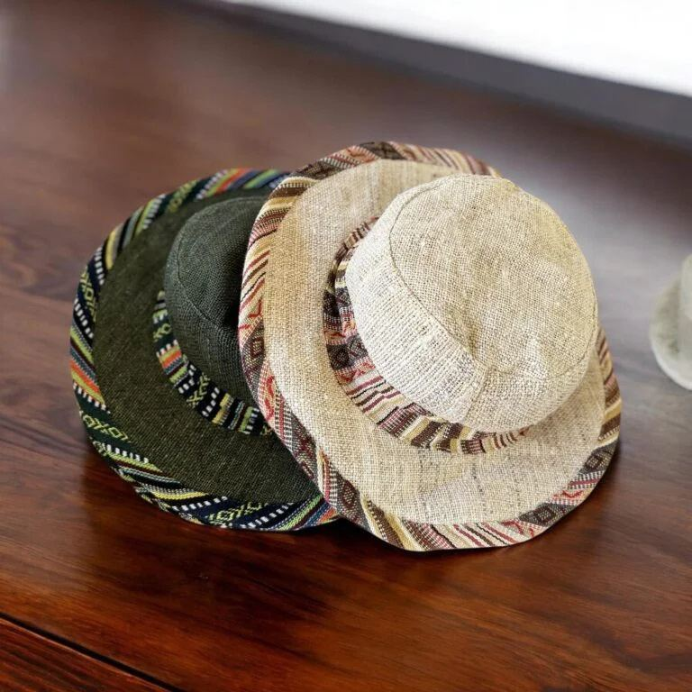
OUR MAIN CATEGORIES
Check out our categories of eco-friendly and sustainable hemp and cotton products that are ethically made in Nepal.
Natural Fiber Hemp Bags
Sustainable hemp headwear

Slide 8
OUR MAIN CATEGORIES
Check out our categories of eco-friendly and sustainable hemp and cotton products that are ethically made in Nepal.
Ethical Clothing in Australia

Slide 9
OUR STORY
We are a couple that shared love for creativity and a passion for sustainable living, and wanted to set out to create a unique business dedicated to handmade products. And thus, our SpreadMaya came to life.
Coming from the same culture and background from Nepal led us to explore the wonders of hemp, a versatile and eco-friendly material. Fascinated by its incredible qualities, we decided to design the product in Australia and handcraft them in Nepal by our talented artisans and we saw an opportunity to showcase its beauty to the world.

Slide 10
01
Promote Sustainable Fashion
OUR MISSION
02
Support Local Artisans
03
Ensure Ethical Sourcing
04
Minimize Environmental Impact
05
Inspire Global Change

Slide 11
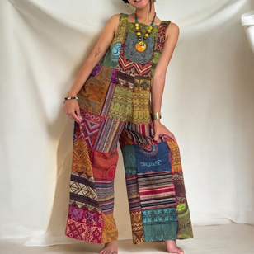

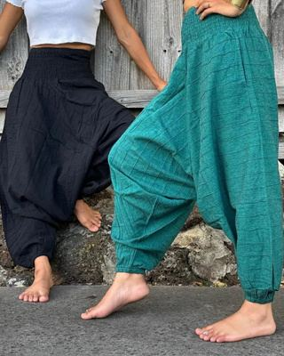
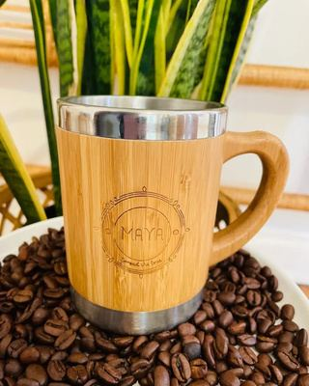
OUR OTHER PRODUCTS
Boho Patchwork Overalls
Himalayan Breeze Dress
Harem Pants for Men & Woimen
Bamboo Mugs and Coffee Cups

Slide 12

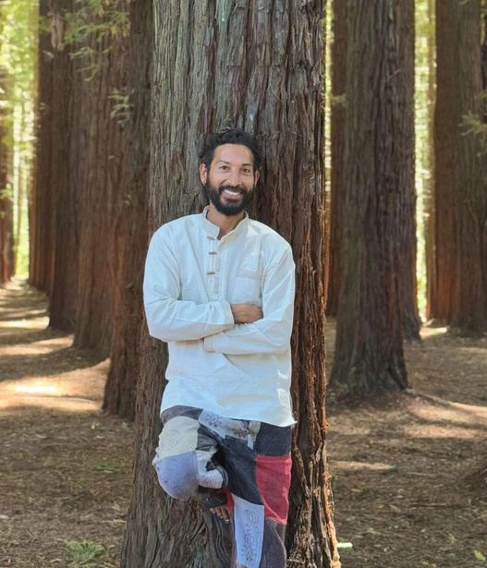
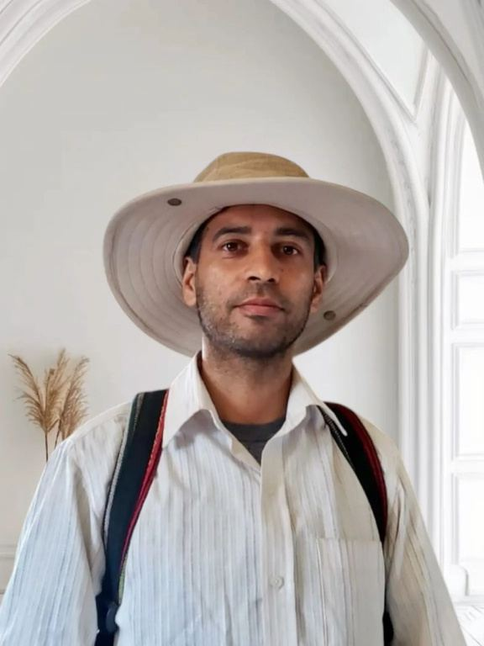
OUR TEAM
Asmita Rajopadhyaya
Suraj Upadhyay
Deepak Upadhyay
Hemp Enthusiast
Hemp Enthusiast
Hemp Enthusiast

Slide 13

Great hats and backpacks. Love the colours and varieties
PRODUCT REVIEW
So beautiful! Gorgeous clothes and wonderful people too

Slide 14

CONTACT US
+61 0481 992 044
https://spreadmaya.com.au
27 Louis St, Doveton VIC 3177, Australia

